Slide 1
Ethical Hacking
Fahad Usman

Slide 2
Email and domain information Gathering
Information Gathering is the process of collecting essential data about the target domain or network. Information can be of various types, like subdomains of the target domain, DNS Information, Port Information, etc.
Hunter.io: Allows you to find email addresses associated with a specific domain.
Voila Norbert: Helps in finding and verifying email addresses.
FindThat.Email: Provides email search and verification services

Slide 3
Domain Information Gathering
WHOIS Lookup
WHOIS Database: Provides detailed information about domain ownership, registration dates, and more. Use sites like:
WHOIS.net
ICANN WHOIS

Slide 4
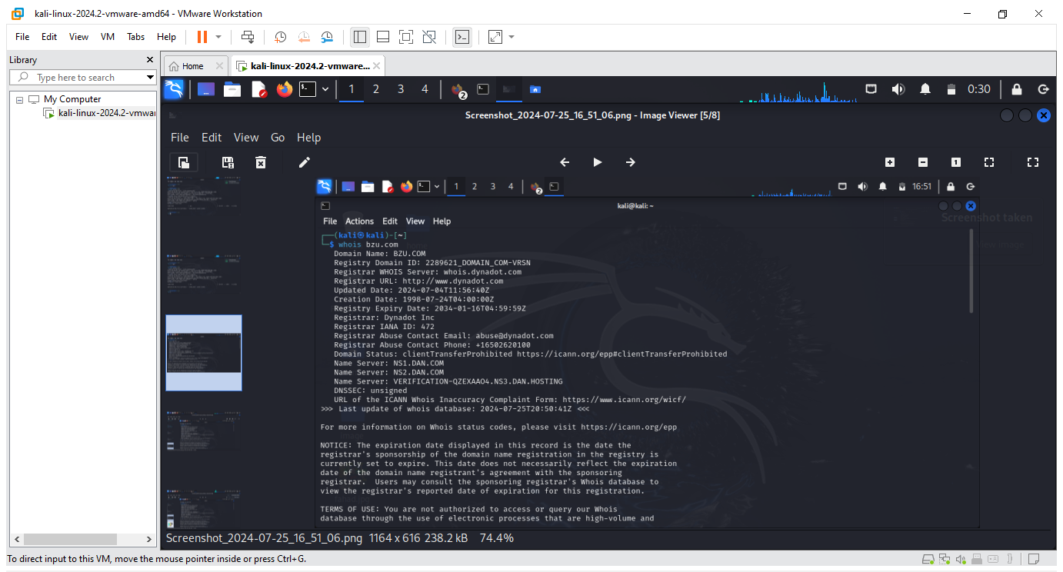

Slide 5
Metadata Analysis
Metadata analysis in cybersecurity refers to the process of examining the data that describes other data, which can provide valuable insight into potential threats or vulnerabilities. This can include details such as file size, creation date, and author, among other things.
File Metadata: Information about a file's creation date, modification date, author, file size, and file type.
Network Metadata: Details about network traffic, such as IP addresses, ports, protocols, and timestamps.
Email Metadata: Information about email headers, sender and receiver addresses, timestamps, and routing paths.

Slide 6
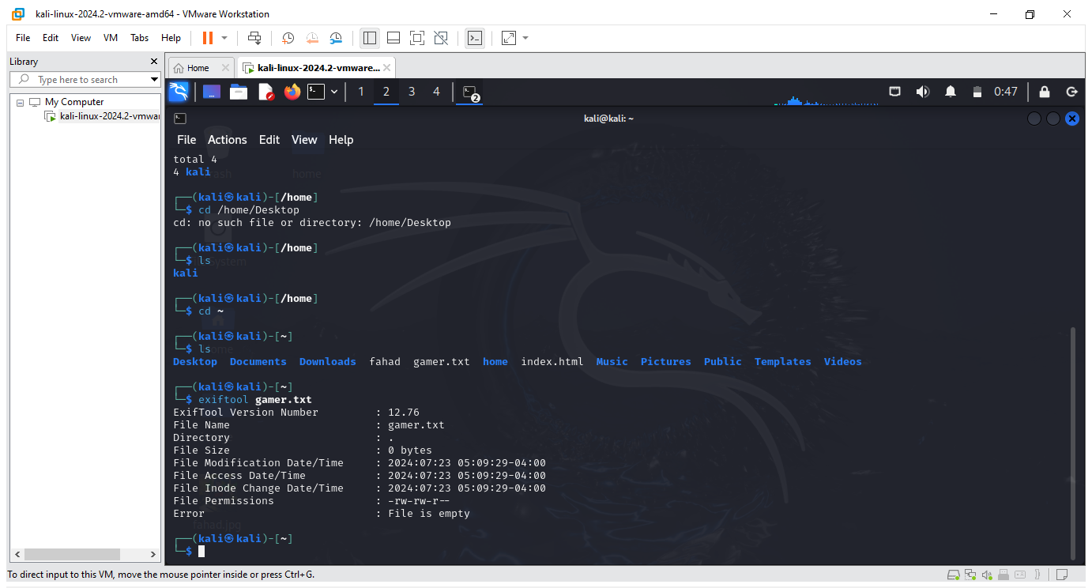

Slide 7
Domain Ownership
Active Directory Domain Services (AD DS) are the core functions in Active Directory that manage users and computers and allow sysadmins to organize the data into logical hierarchies. AD DS provides for security certificates, Single Sign-On (SSO), LDAP, and rights management.
Gtmetrix
Shodan
MXToolbox
SSL lab
Whois.net

Slide 8
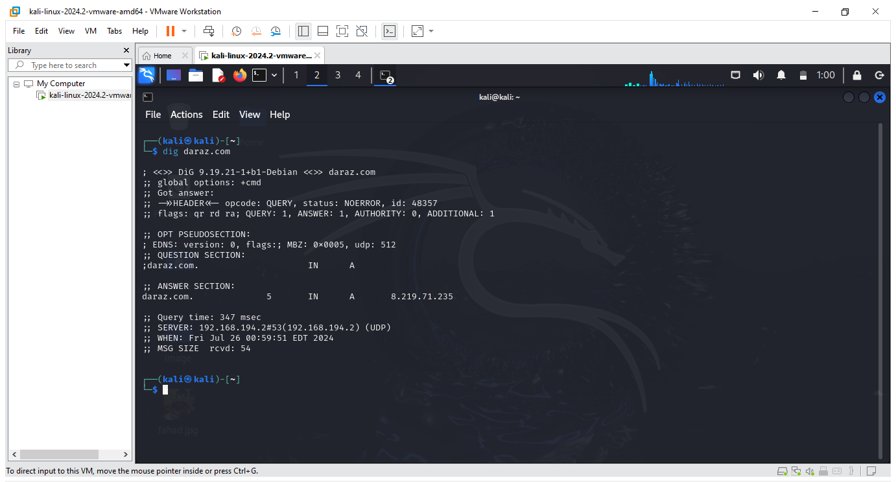

Slide 9
DNS Enumeration
DNS enumeration is a critical process in cybersecurity that uncovers all DNS records associated with a domain, providing valuable insights for security professionals and cybercriminals alike. By detailing hostnames, IP addresses, and DNS record types, it reveals a domain’s footprint and potential vulnerabilities.
The process of DNS enumeration involves discovering and accounting for all possible DNS records of a domain name. This includes:
Hostnames
DNS record names
DNS record types
TTLs
IP addresses

Slide 10
Website name which is used for the DNS Enumeration are following.
Spoken.com
Metadata2go
Virustotal.com
Clear Bit connect
ViewDNS
DNSViz
Tools use in kali lunix are as follow.
dnsenum example.com
dnsenum --enum --threads 5 --dnsserver 8.8.8.8 example.com
fierce --domain example.com

Slide 11
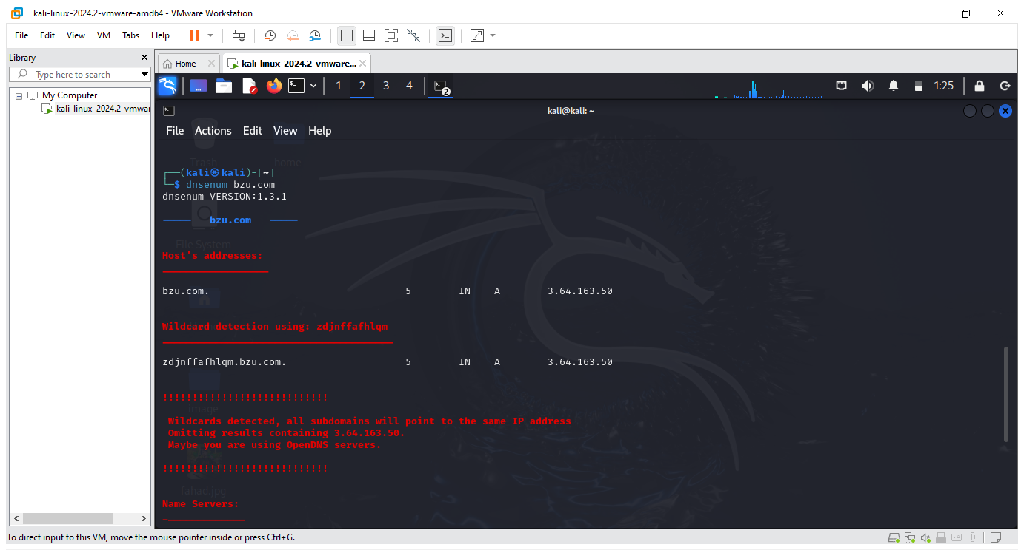

Slide 12
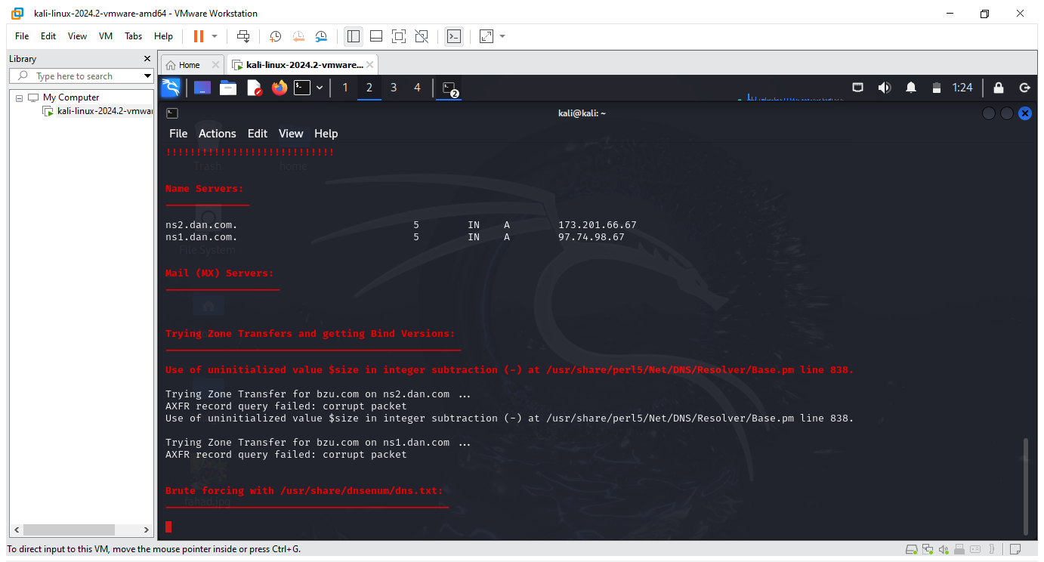

Slide 13
Examples
Port Scanning:
Example: Scanning a network using Nmap reveals that ports 22 (SSH), 80 (HTTP), and 443 (HTTPS) are open on a server, indicating that these services are running.
Example: A network scan shows that port 3306 (MySQL) is open on a database server, providing insight into the services that could be targeted or secured.
Service Version Detection:
Example: Using Nmap with version detection (-sV), it is identified that the HTTP service on port 80 is running Apache 2.4.41.
Example: A version scan reveals that the SSH service on port 22 is running OpenSSH 7.9, which can then be checked for known vulnerabilities.

Slide 14
Techniques and Tools/Websites
Port Scanning:
Techniques: Scanning a network for open ports to identify active services.
Tools/Websites:
Nmap: nmap -p 1-65535 example.com
Masscan (for very large networks or fast scans): masscan -p1-65535 192.168.1.0/24
Service Version Detection:
Techniques: Scanning open ports to detect the software and version running on those ports.
Tools/Websites:
Nmap with version detection: nmap -sV example.com
Banner Grabbing with Netcat: nc -v example.com 80

